Slide 1
Predictive Analytics in Business: Wine Price Prediction
Qian Fu
This presentation has been designed using resources from PoweredTemplate.com

Slide 2
Wine Price Prediction
Overview:
My stakeholder and the problem I am solving.
Introduction to the data
Demonstration of the key findings
Description of the strengths and limitations of the model
Recommendations

Slide 3
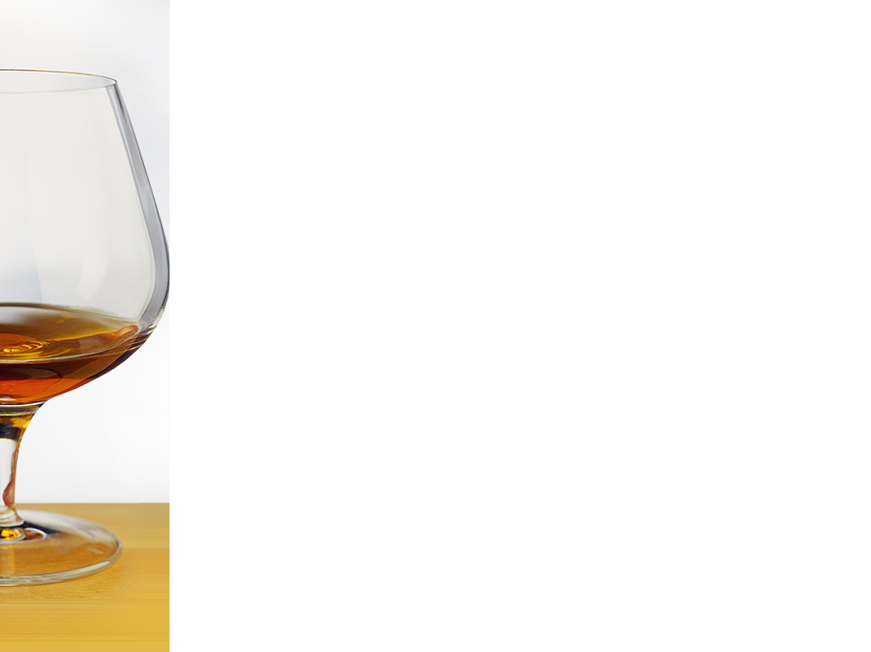

Who are interested in my project?
Stakeholders
Grape grower
Wine
maker
Private winery
Whole
saler
Super
market
Specialty
shop
Wine
consumer

Slide 4
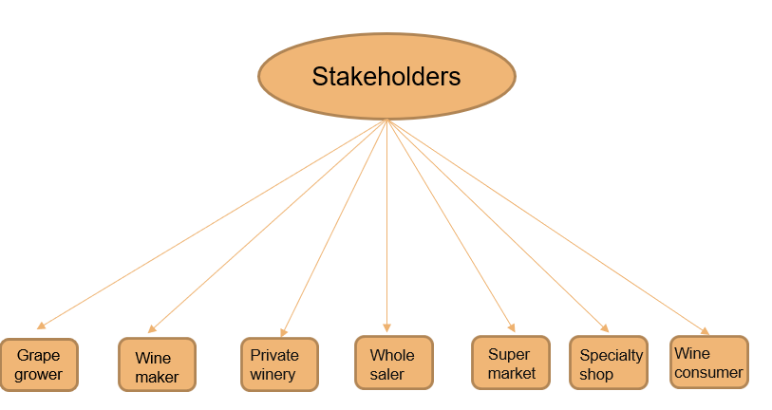
Who are interested in this project?
What is the problem solved in this project?
The problem is to predict the price of the red wine based on some factors like the region of the wine is made, the rating score of the wine, and which year the grapes were harvested.

Slide 5
Wine Price Prediction
Introduction of the data
This dataset is related to red variants of Spanish wines. The dataset describes several popularity and description metrics their effect on its quality.
The dataset contains 7500 different types of red wines from Spain with 11 features that describe their price, rating, and even some flavor description.
Below are some features that make big impact on the price of the wine:
Rating: average rating given to the wine by the users [from1-5]
Region: region of the wine: where the wine is produced in Spain
Type: wine variety.

Slide 6
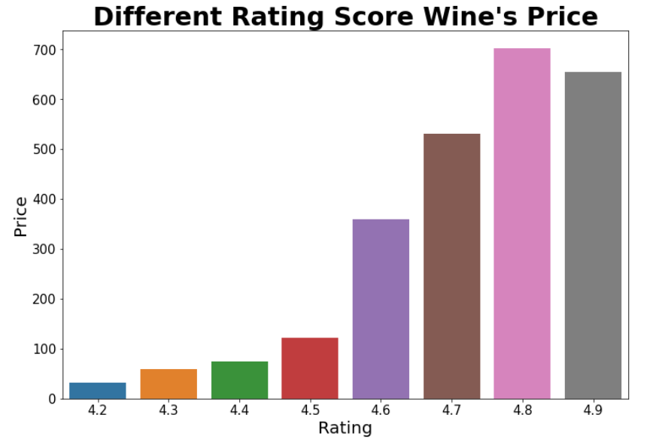
Wine Price Prediction
Wine price influenced by the rating score
Thoughts about this visualization:
What is this visualization about?
This is a bar chart
x axis: rating score, y axis: wine price.
Lowest rating score:4.2, highest rating score:4.9.
Lowest price: under 50$, highest price: about $700.

Slide 7
Wine Price Prediction
Wine price influenced by the rating score
Key findings:
What can I know from this visualization?
General trend: higher rating score, higher price.
The price gap between the lowest score wine and the highest score is considered as substantial.
The rating score under 4.5, the price under $100, the price gap between each rating score(4.2-4.5) is considered as small.
The rating score between 4.6-4.9, the price jump from $350 to $700. The price gap between each rating score is considered as substantial.
The highest price wine doesn’t score highest.

Slide 8
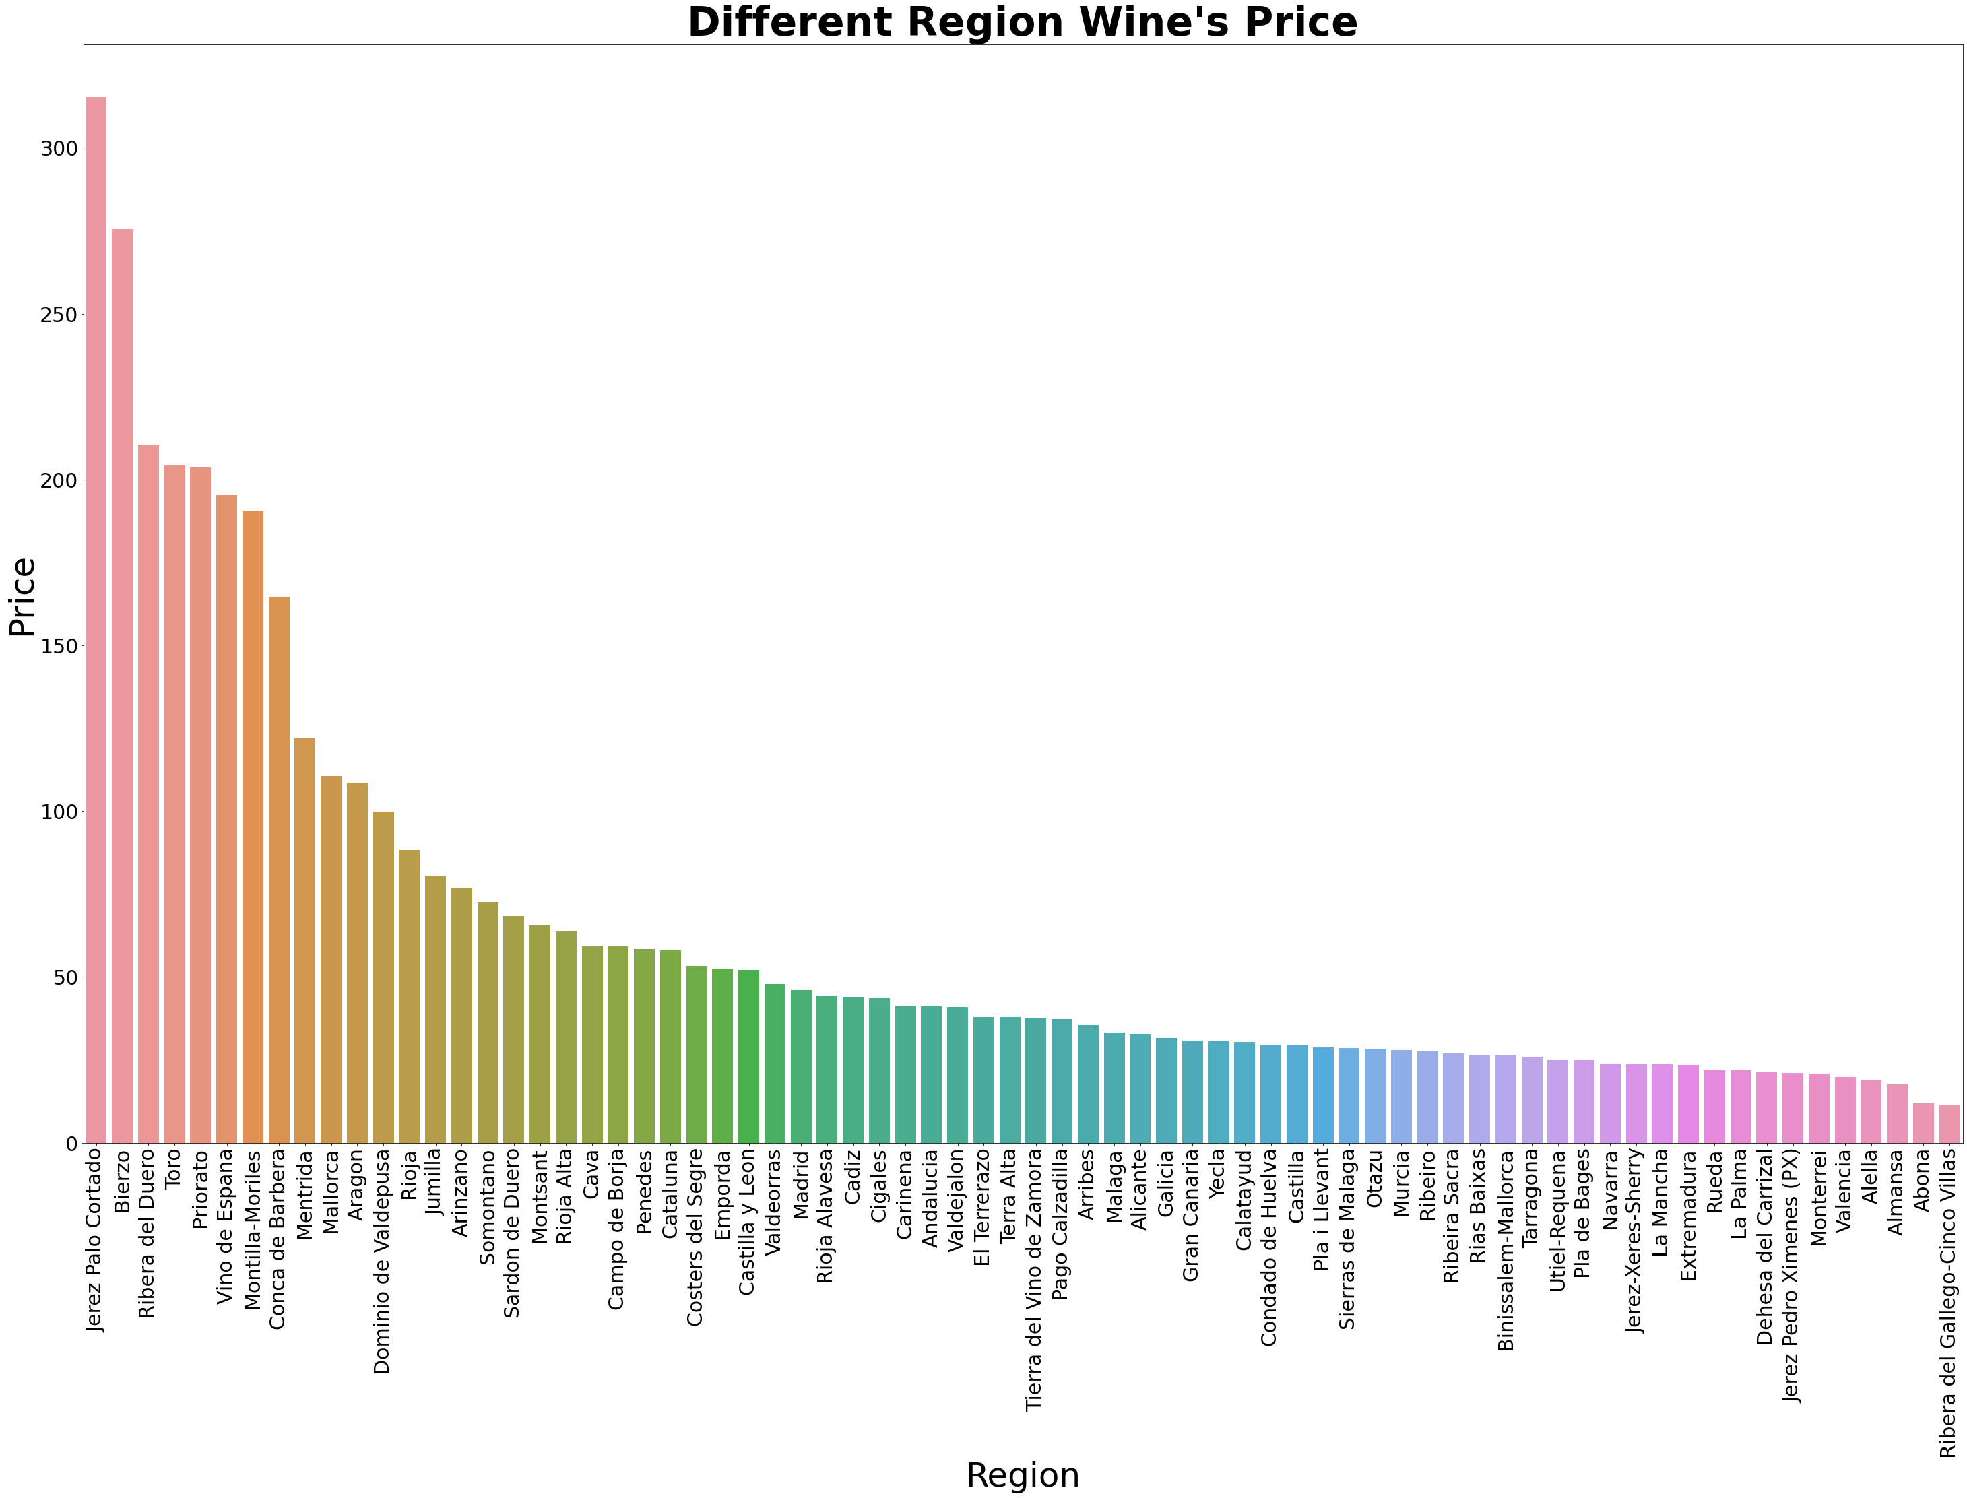

Wine Price Prediction
Wine price influenced by the regions
Thoughts about this visualization:
What is this visualization about?
There are total 76 regions
x axis: region, y axis: wine price.
Highest price is above $350, lowest price is under $50.

Slide 9
Wine Price Prediction
Key Findings:
What can I know from this visualization?
The gap between the highest price and lowest price is considered as substantial.
Only few regions produce the expensive wine
Most of the regions produce the wine price under $50
If we group the price into high, medium, and low, the price in each group is very similar which there is nearly no price gap between.
Key Findings

Slide 10
Wine Price Prediction

Slide 11


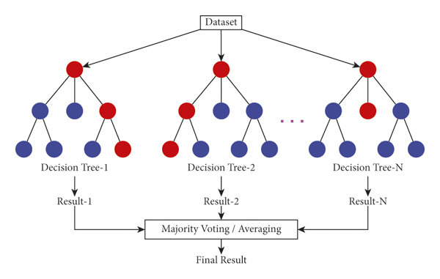
Thoughts about the model:
Random Forest Model
What does this look like?

Slide 12
Thoughts about the model:
Random Forest Model
Why I chose this model as the best model. I think can make the most accurate prediction.
I tried all other models and made evaluation of each model.
Evaluation metric: R2 score.
The higher R2 score, the more accuracy of the prediction.

Slide 13
Recommendations
Questions we can think about that can help us understand more how the wine price is influenced by some the most popular factors.
These questions driven by the key findings from the two visualizations:
Why the wine has the highest rating score is not the most expensive wine?
Why only few regions in Spain produce better quality wine?
What are the characters of these few regions compare to other regions that produce cheaper wine?

